Slide 1

Shared Genetic Determinants Between the Brain Functional Connectome and Psychiatric Disorders
Daniel Roelfs
University of Oslo

Slide 2
No disclosures to declare
Slide added to comply with ACCME accreditation guidelines

Slide 3
BACKGROUND
Psychiatric conditions are highly polygenic and complex¹
Psychiatric conditions share symptoms and genetic profiles²
MRI studies show that structural and functional changes are widespread across the brain³
Investigate distributed nature of genetic effects in the brain and its associations with psychiatric conditions
1. Antilla et al. Science (2018), Sullivan & Geschwind Cell (2019), Paulus & Thompson JAMA Psychiatry (2019)
2. Plana-Ripoll et al. JAMA Psychiatry (2019), Roelfs et al. Transl. Psychiatry (2021)
3. Petterson-Yeo et al. Neurosci. Biobehav. Rev. (2011), Arnatkeviciute et al. NeuroImage (2021)

Slide 4
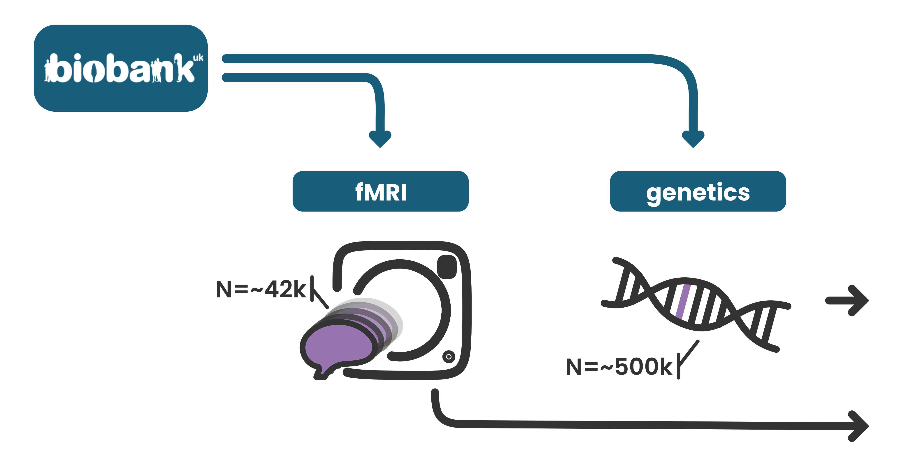
DATASET

Slide 5
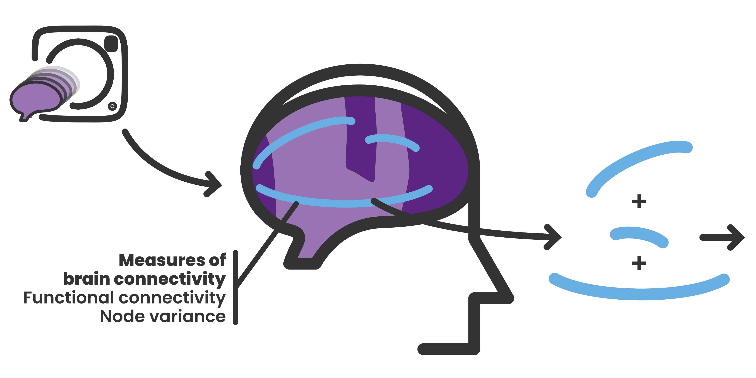
BRAIN FUNCTIONAL CONNECTIVITY

Slide 6
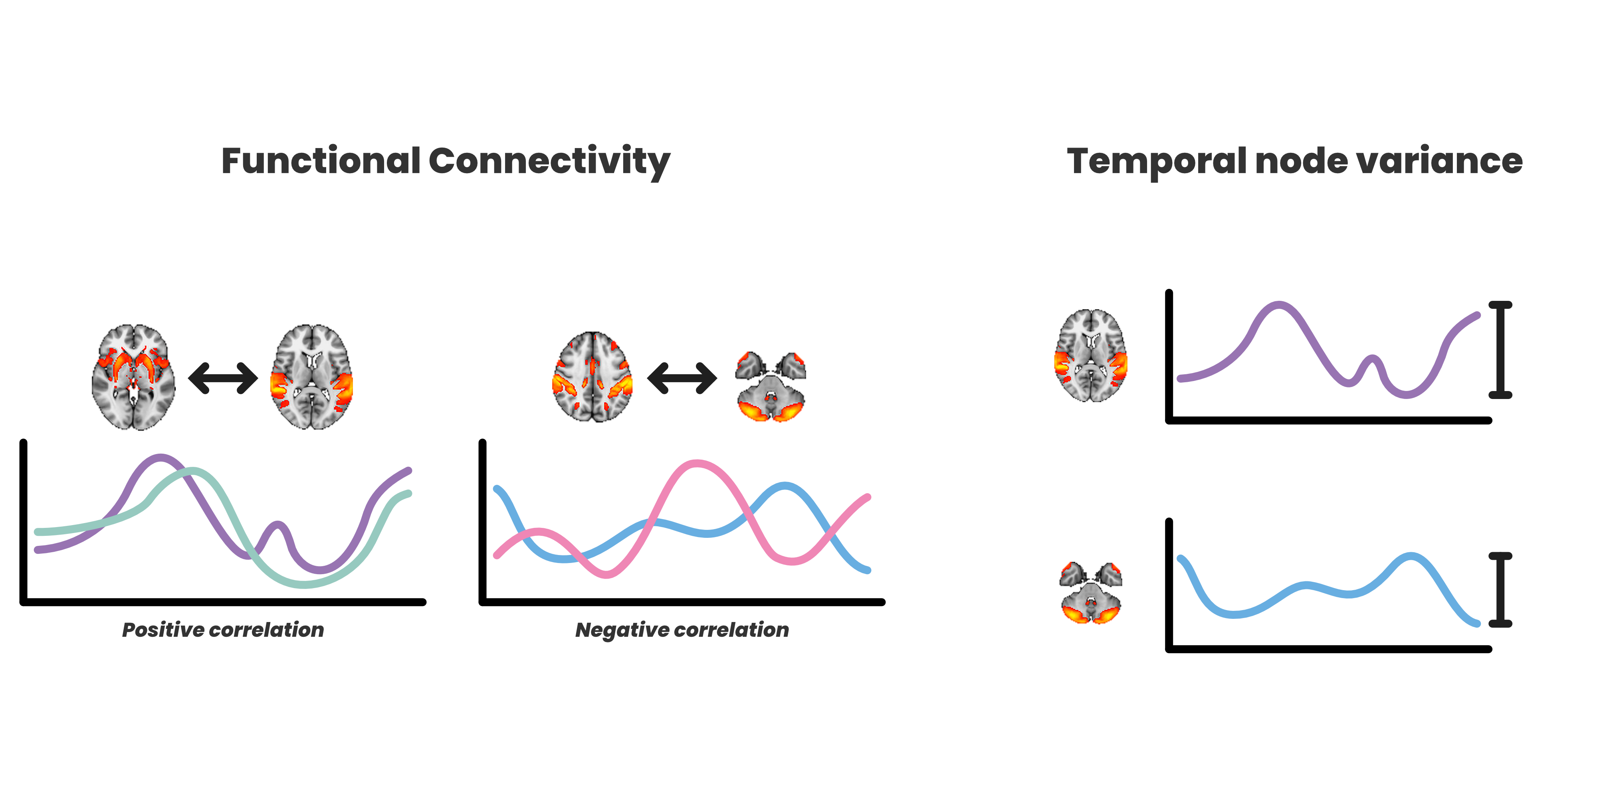
BRAIN FUNCTIONAL CONNECTIVITY

Slide 7
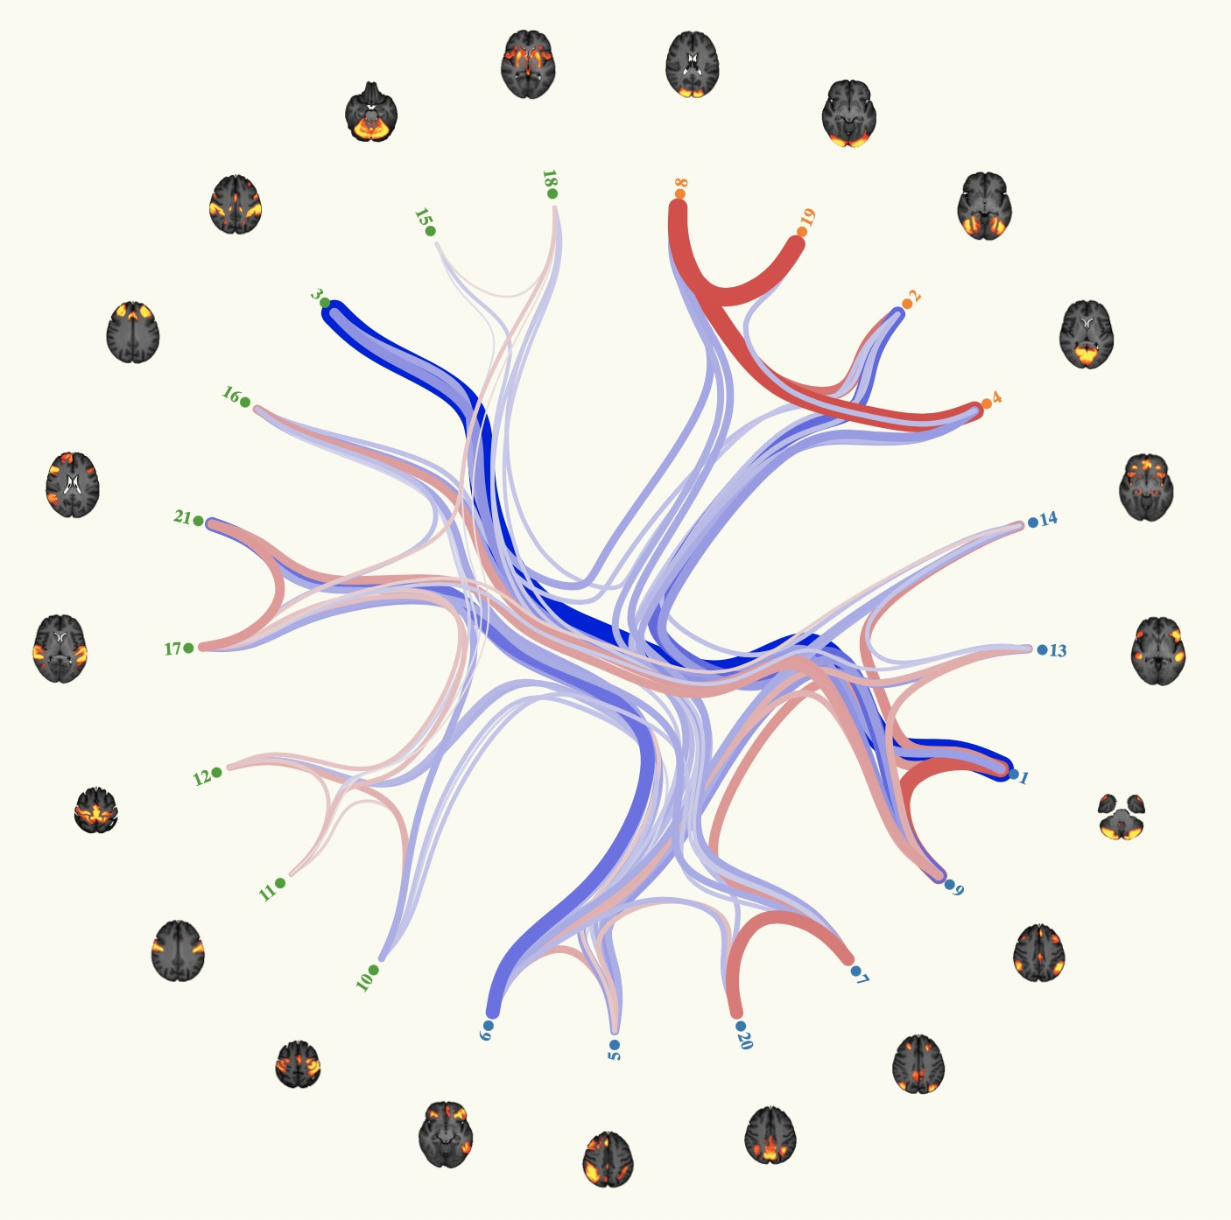
BRAIN FUNCTIONAL CONNECTIVITY
UK Biobank Brain Imaging - Connectome Browser (d25)

Slide 8
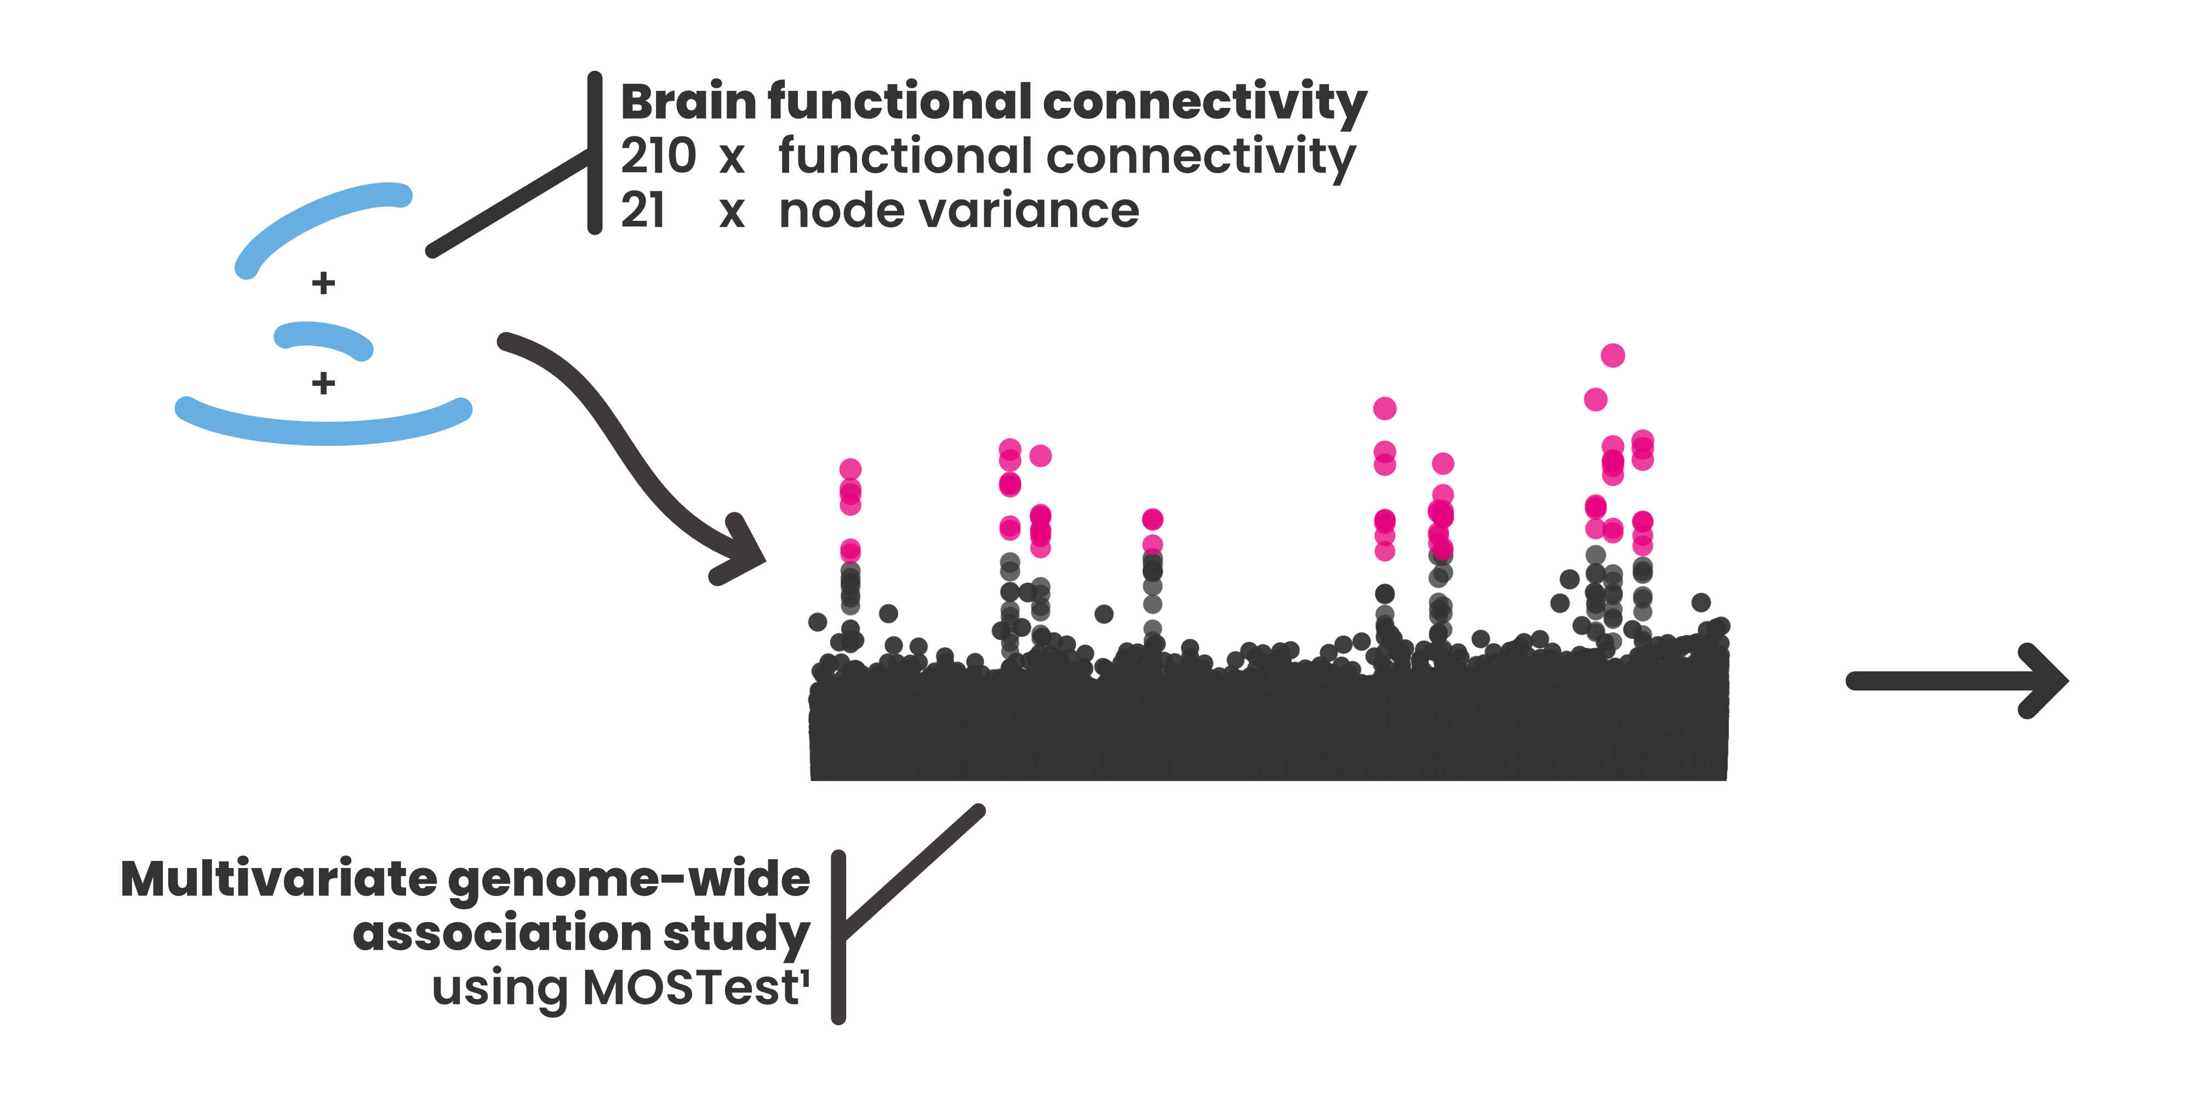
MULTIVARIATE GWAS
1. van der Meer et al., Nature Communications (2020), github.com/precimed/mostest

Slide 9
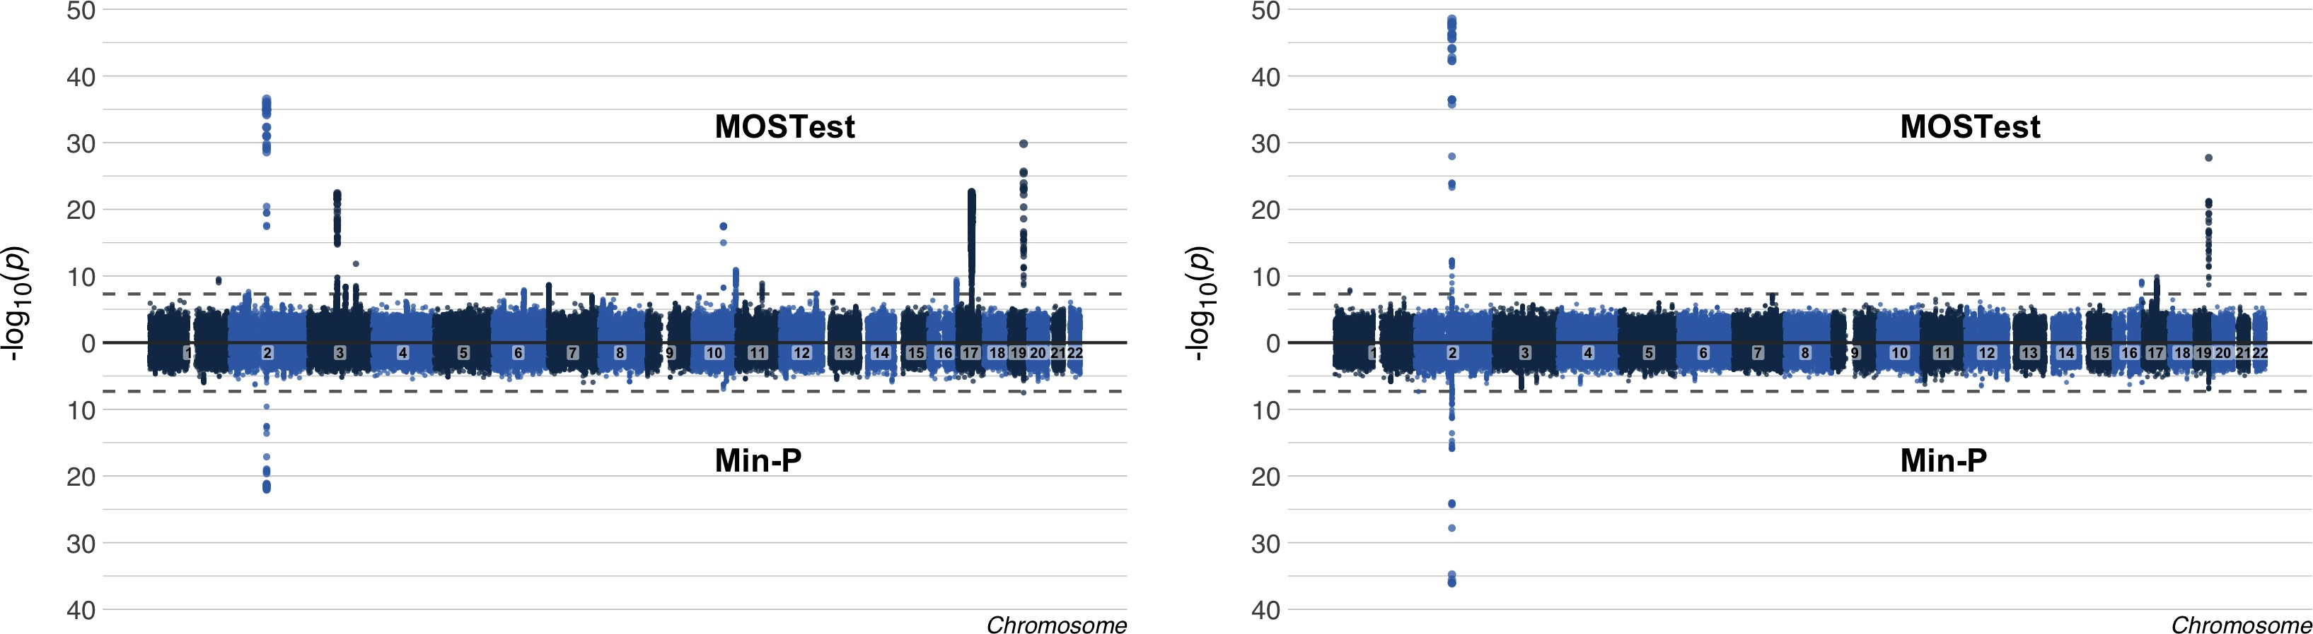
MOSTEST MANHATTAN PLOTS
Functional connectivity
Node variance
MOSTest
Min-P
15 loci
2 loci
MOSTest
Min-P
5 loci
3 loci

Slide 10
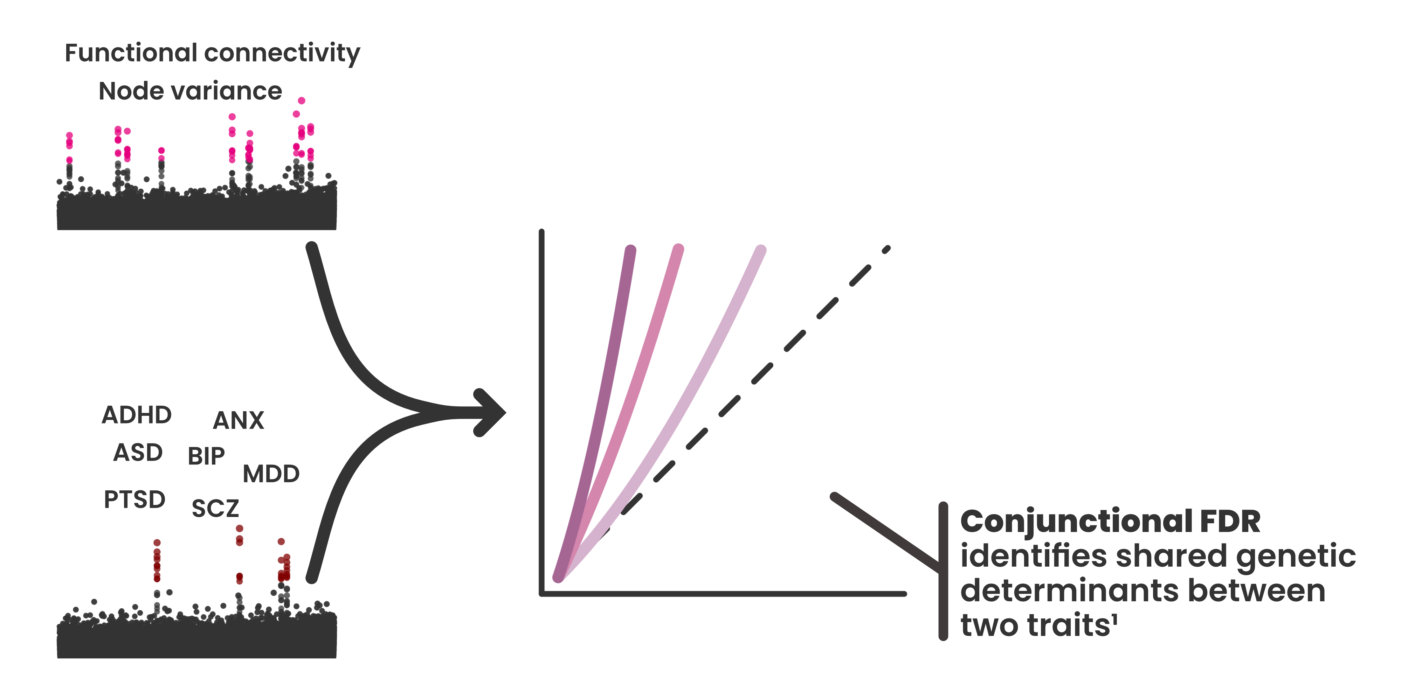
GENETIC OVERLAP
1. PleioFDR, Andreassen et al., PLoS Genetics (2019), github.com/precimed/pleiofdr

Slide 11
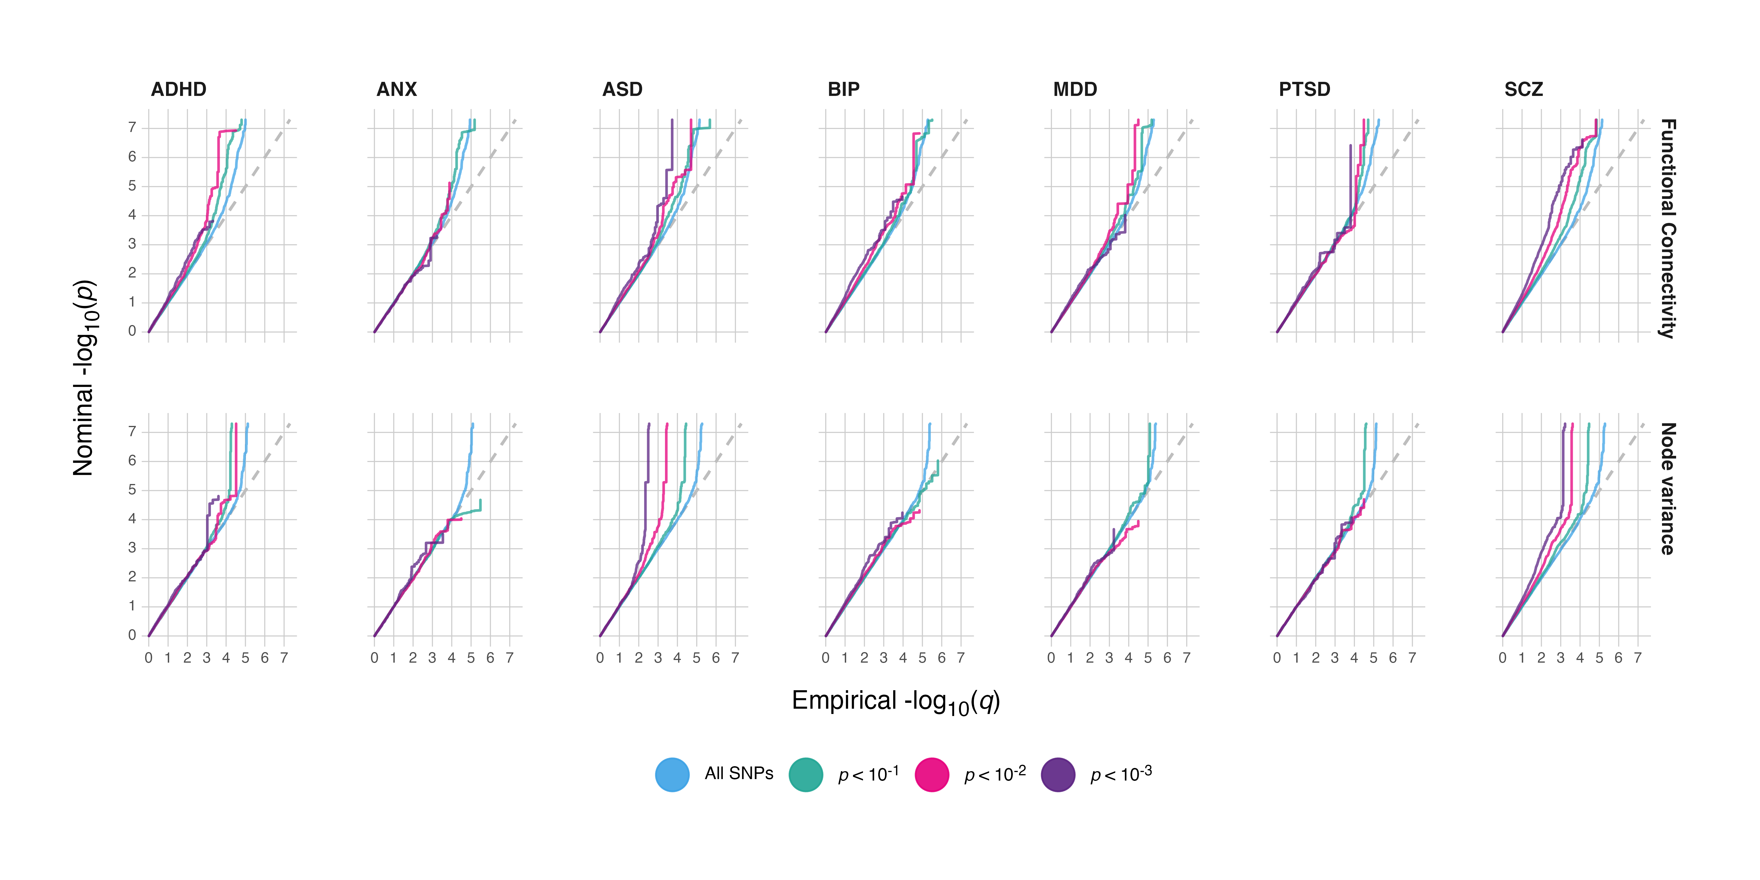
CONJUNCTIONAL FDR

Slide 12
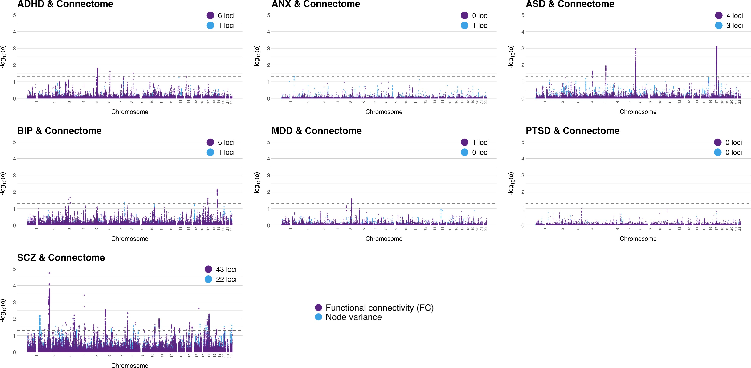
CONJUNCTIONAL FDR

Slide 13

Functional annotation and mapping of genome-wide associaton studies (FUMA¹)
MAPPED GENES
Gene set mapped from the significant loci in the GWAS
Compare identified genes to genes involved in synapses (e.g. BDNF, NRXN1 etc.)²
Watanabe et al., Nature Communciations (2017)
SynGo, Koopmans et al., Neuron (2019)

Slide 14
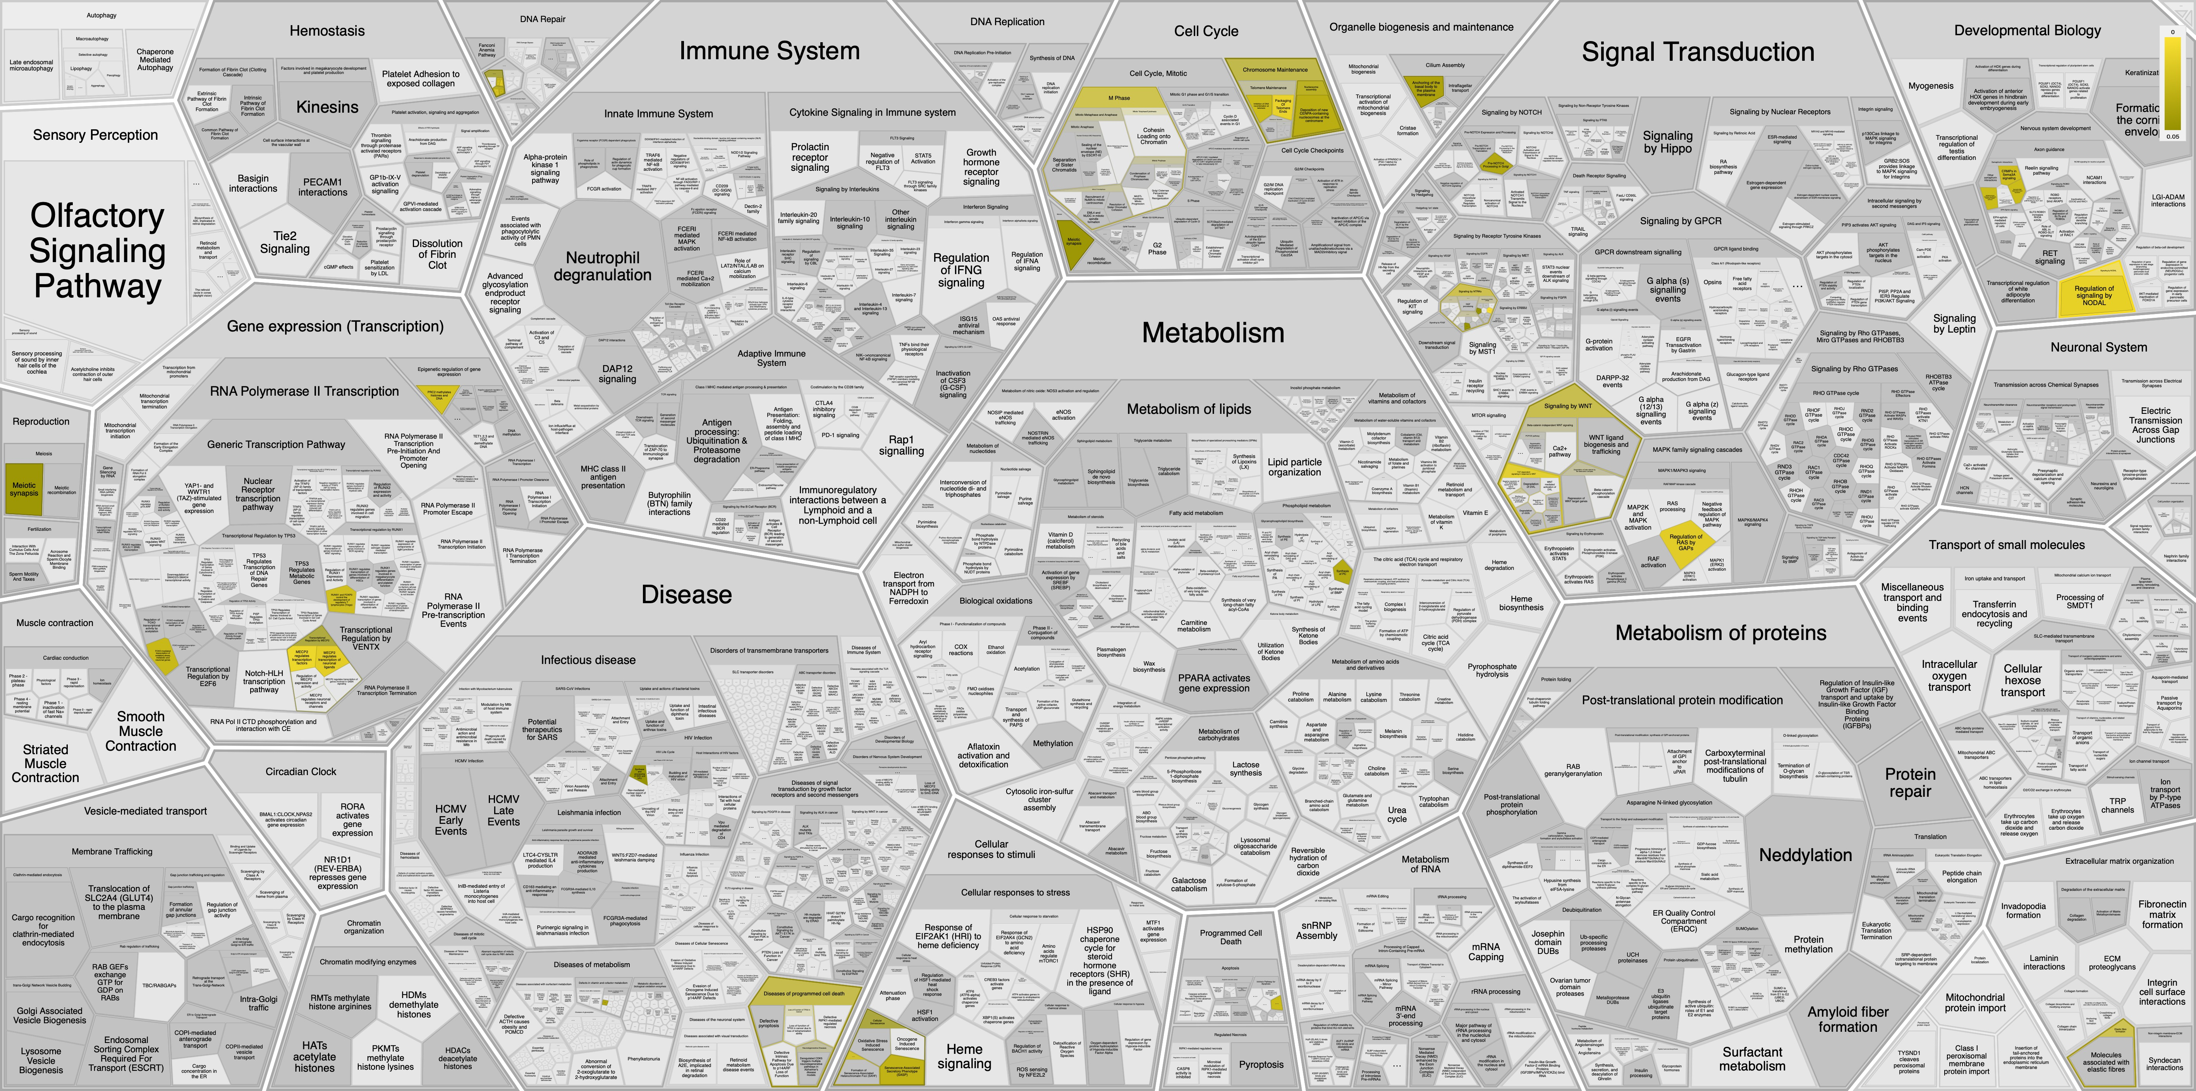
MAPPED BIOLOGICAL PROCESSES
Reactome Pathway Database, Jassal et al., Nature Communications (2020)

Slide 15




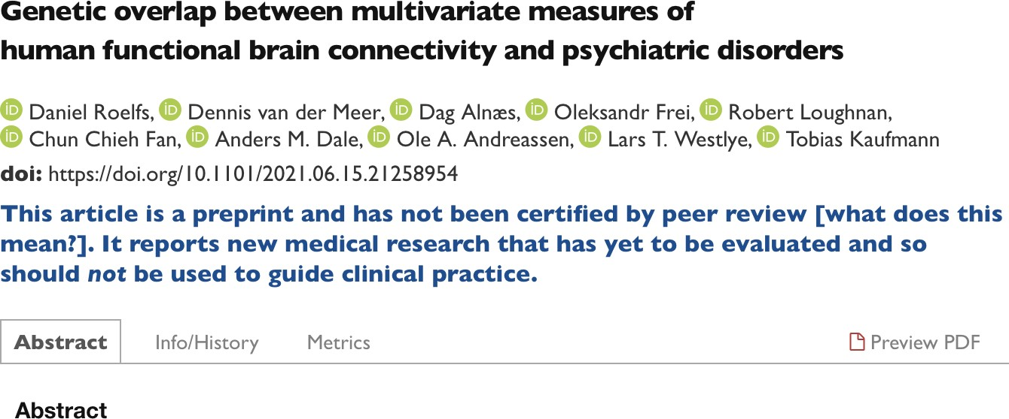
CONCLUSION
Genetic overlap between functional connectivity and psychiatric conditions
Link genetic loci back to biological processes implicated in psychiatric conditions
Identified a number of synaptic processes associated with shared loci
bit.ly/network_genetics_pre

Slide 16











Thanks to
ERA-NET
SYNSCHIZ
Linking synaptic dysfunction to disease mechanisms in
schizophrenia

